Slide 1
Analysis : Massive Open Online Course (MOOC) Sales Drivers
Mini Project 1

Slide 2

Contents :
Business Problem
Background
Data Problem
Stakeholders
Data set
Analysis
Results
Recommendations
Next Steps

Slide 3
Business Problem :
Recently the newly appointed global Director of Sales in HQ has requested an analysis for the courses offered under Category : “Development” in India under his portfolio as he feels there is room for improvement.
His main concerns are looking into ways at increasing sales and he hopes to gain additional insights with the analysis to help with overall strategy for his sales team in India.

Slide 4
2. Background :
The company is an American massive open online course (MOCC) provider aimed at professional adults and students with hubs across the globe.
Through a platform that allows instructors to build online courses on their preferred topics and courses are offered across a breadth of categories and are either paid or free.
Development Category has courses from Finance, Accounting, Bookkeeping, Compliance, Cryptocurrency, Blockchain, Economics, Investing & Trading, Taxes and etc.

Slide 5
3. Data Problem :
You are part of the Analytics team based in USA HQ tasked with this project. Below are key areas of focus after discussion with the team :
Which courses are generating highest sales?
What kind of courses are more popular?
Are prices a factor?
Does ratings and reviews influence the courses’ sales?

Slide 6
4. Stakeholders :
Global Director of Sales in USA HQ
Sales Team in India
Analytics team

Slide 7
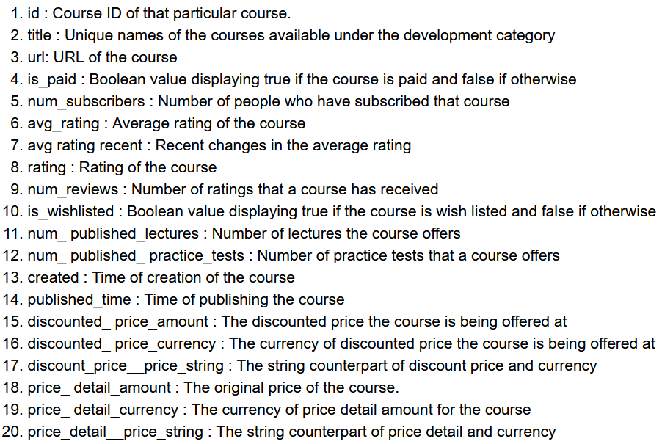
5. Data Set : From 2010 to 2020

Slide 8
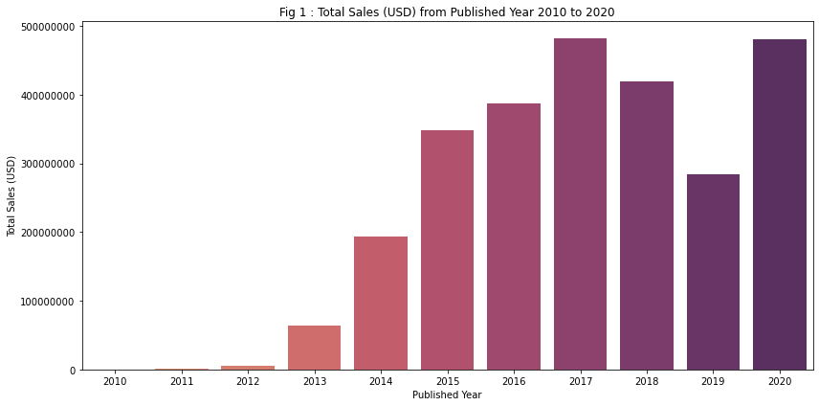
6. Analysis : Total Sales

Slide 9
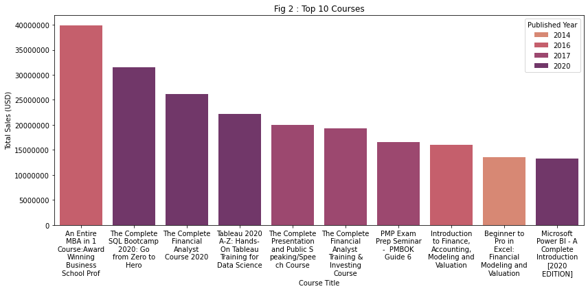
6. Analysis : Which courses are generating the highest sales?

Slide 10
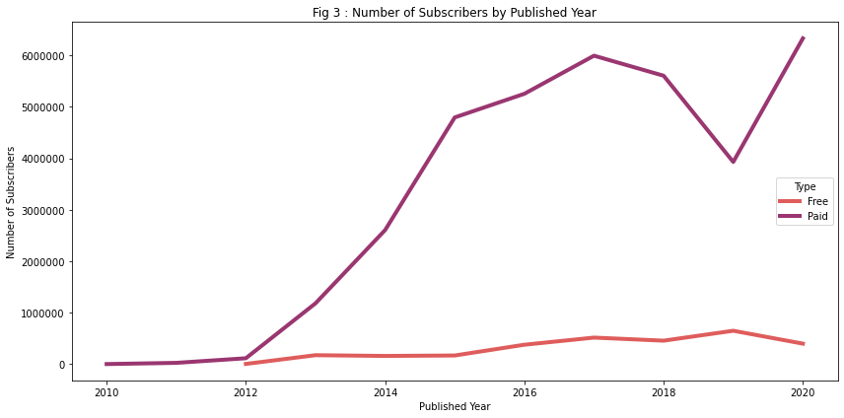
6. Analysis : Subscribers

Slide 11
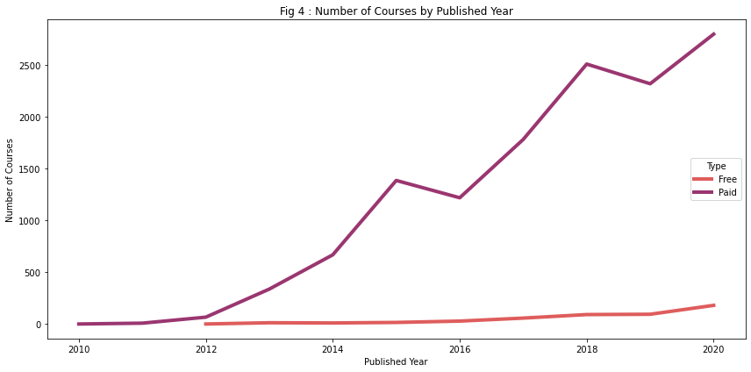
6. Analysis : Number of Courses

Slide 12
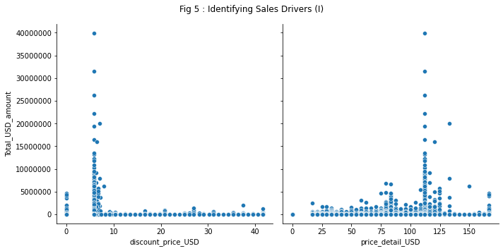
6. Analysis : Sales Drivers (I)

Slide 13
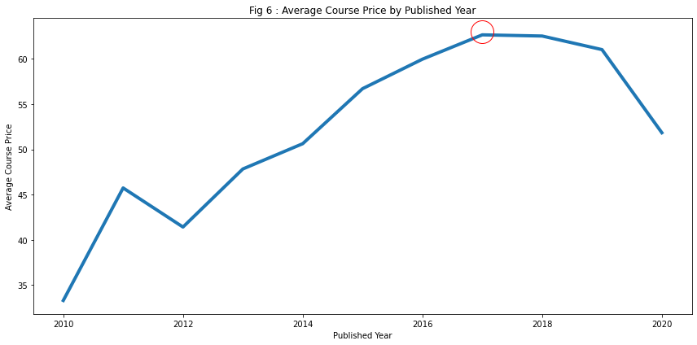
6. Analysis : Average Course Price

Slide 14
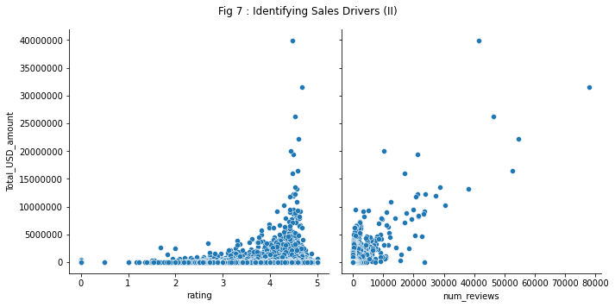
6. Analysis : Sales Drivers (II)

Slide 15
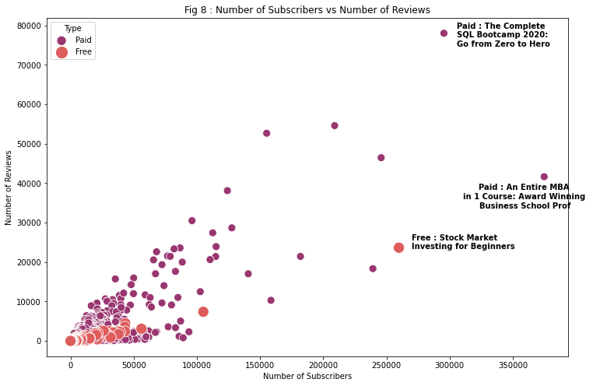
6. Analysis : No. Subscribers vs No. Reviews

Slide 16
7. Results :
Outliers identified shows that instructor popularity is a sales driver
Top 10 courses are mostly in analytics
Number of courses are increasing on par with number of subscribers
Small amount of discount are shown to be effective
Course prices that are too high will be less taken up
Popular free courses are mostly Introductory courses

Slide 17
8. Recommendations :
More collaborations with well known instructors
To keep course prices competitive ie around threshold USD 115
Introductory level free courses are shown to popular, it gives potential subscribers exposure to other available courses of interest, can be effective to showcase new instructors

Slide 18
9. Next Steps :
To identify current trending courses to improve based market demand (ie after the pandemic)
Sentiment analysis on subscribers’ reviews to gauge their opinion and understand their course experience

